Slide 1

Capstone Project Walmart Weekly Sales
Intellipaat
Executive-Post-Graduate-Certification-in-Data-Science-and-Artificial-Intelligence
Date- Oct 2024

Slide 2
Contents
1
Problem Statement
9
Inferences from the Same
2
Project Objective
10
Future Possibilities of the
Project
3
Data Description
11
Conclusion
4
Data Pre-processing Steps
and Inspiration
5
Choosing the Algorithm
for the Project
6
Motivation and Reasons For
Choosing the Algorithm
7
Assumptions
8
Model Evaluation and
Techniques

Slide 3


The Problem Statement
Walmart is an American multinational retail corporation that operates a chain of hypermarkets, discount department stores, and grocery stores in the United States.
It has been facing issues in managing inventory - to match the demand with respect to supply.
It has requested Intellipaat to come up with useful insights using their data and make prediction models to forecast the sales for 12 to 16 weeks.
It has provided last 3 years weekly sales data containing 6435 rows and 8 columns to enable data prediction.

Slide 4
Project Objective
Insights
Identify store with Max and Min sales
Features
Heat map of all features with one another
Identify and remove features having outliers
Predictive models
Analyze what Machine Learning will fit the requirement
Analyze Time Series- ARIMA and SARIMAX
Pre- processing
Data type of columns
Shape of data
Handle Null values
Handle Duplicates values
Analyze Unique values for each column
Identify Top 5 and Bottom 5 stores by Sales
Diff between Max and Min Sales
Identify Week of Max sales across all stores
Graph- Sales by Store Number
Analyze impact of Annual Year, Unemployment and CPI on Sales
Correlation of Unemployment & CPI with Sales
Present sales predictions using time series graph

Slide 5
Pre Processing

Slide 6
Pre- processing
Dataset Overview:
6435 rows
8 columns
Data Types:
Store- Store number [int64 ]
Date- Week of Sales [object
Weekly_Sales- Sales for the given store in that week [float64]
Holiday_Flag- if it is a holiday week [int64]
Temperature- Temperature on the day of the sale [float64]
Fuel_Price- Cost of the fuel in the region [float64]
CPI- Consumer Price Index [float64]
Unemployment- Unemployment Rate[float64]

Slide 7
Pre- processing
Null and Duplicates:
There are No Null nor Duplicate values in the Dataset
Number of Unique values:
Store 45
Date 143
Weekly_Sales 6435
Holiday_Flag 2
Temperature 3528
Fuel_Price 892
CPI 2145
Unemployment 349

Slide 8
Insights

Slide 9
Insights
Store number 14 was found to have max sales= USD 3818686.45 in the week ending 24 Dec 2010
Top 5 stores for Sales are - 14, 20,10, 4, 13
Store number 33 was found to have max sales= USD 209986.25 in the week ending 3 Dec 2010
Bottom 5 stores for Sales are – 33, 33, 33, 33, 33 [Interestingly all the 5 the bottom slot was taken by Store 33]
Difference between maxium sales and minimum sales- USD 3608700
Weeks for max sales across all the stores combined by Total Sales were
24 Dec 2020
23 Dec 2011
25 Nov 2011
26 Nov 2010
17 Dec 2010

Slide 10
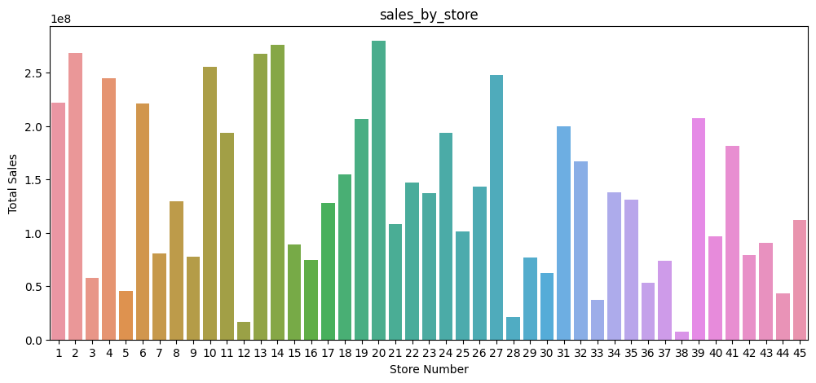
Insights- Sales by Store Number

Slide 11
Features

Slide 12
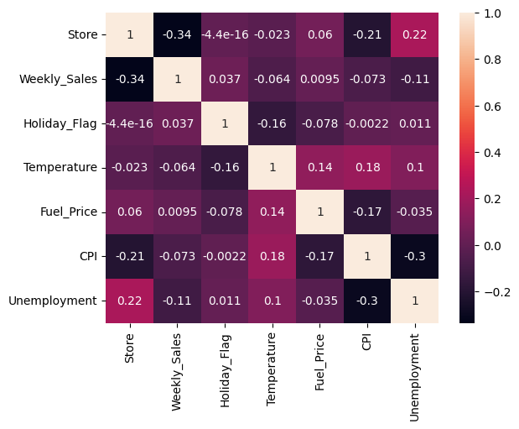
Features- Heat Map
Insignificant +ve and –ve correlations found for external factors with Weekly Sales
Correlation of Weekly_Sales with
Holiday Flag:
0.037 (low +ve correlation)
Temperature:
-0.064 (low -ve correlation)
Fuel Price:
0.0095 (very low +ve correlation)
CPI:
-0.073 (low -ve correlation)
Unemployment:
-0.11 (low -ve correlation)

Slide 13
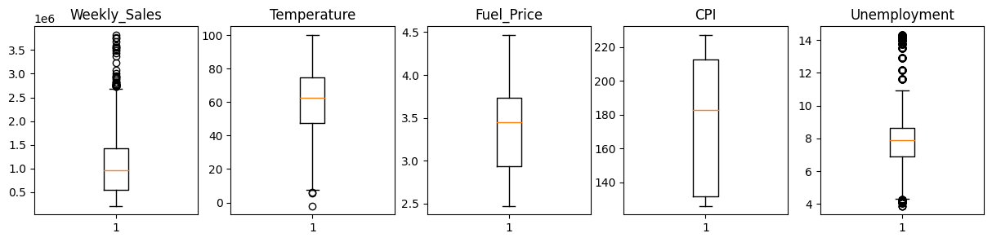
Features- Outliers
Outliers were found and removed from the following columns using the IQR Method
Weekly Sales
Temperature
Unemployment

Slide 14
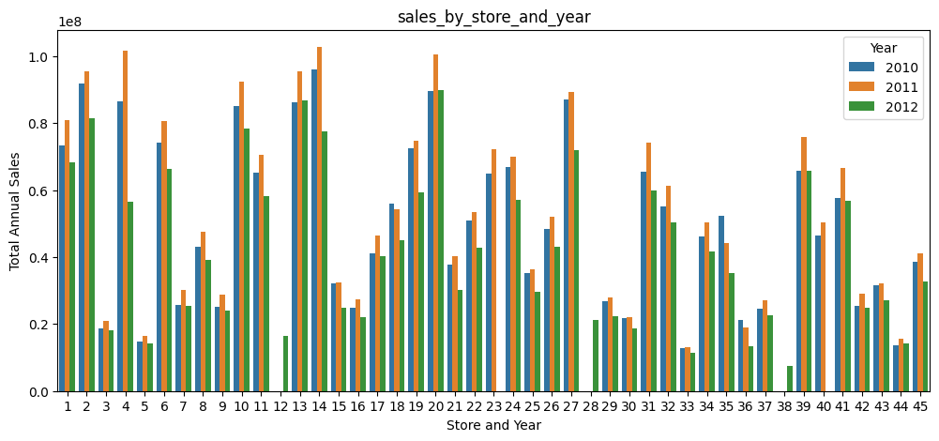
Features- Impact of Annual Year on Sales
Sales were found to be high for year 2011.
This is because the sales data is available fully for 2011.
However sales data is only partially available for 2010 and 2012

Slide 15
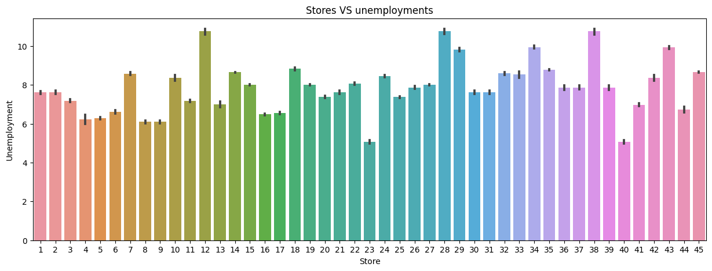
Features- Impact of Unemployment on Sales
Store 40 and 23 area had minimum unemployment
Store 12, 28, 38 area had maximum unemployment
Store 44- had maximum negative correlation with unemployment
So, with increase in unemployment Store 44 had max reduction in Sales
Stores 36- had maximum positive correlation with unemployment
So, with increase in unemployment Store 36 had max increase in Sales

Slide 16
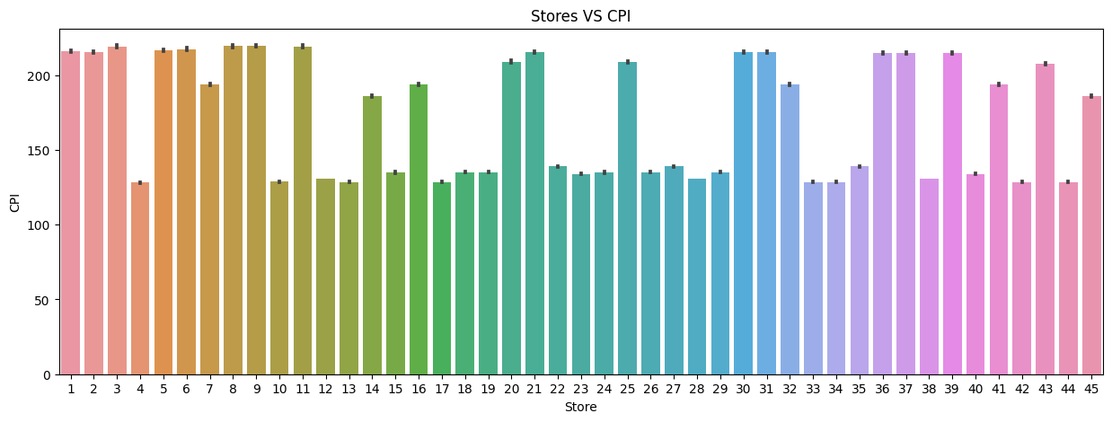
Features- Impact of CPI on Sales
Store 1,2,3,5,6,8,9,11, 30,31 had max increase in CPI
Store 38 had max negative correlation
With increase in CPI, sales of store 38 reduced maximum
Store 44 had max positive correlation
With increase in CPI, sales of store 44 also increased maximum

Slide 17
Prediction Models

Slide 18
Predictive Models
Choosing the right model
Data set has columns like CPI, unemployment, temperature, holiday and fuel price.
We do not have future trend of CPI, unemployment, temp, holiday and fuel price columns for 12 to 16 weeks.
Prediction of Weekly Sales can not be done using traditional ML Algorithms such as Linear Regression, Decision Tree, Random Forest since they will need these column details completely.
Future prediction needs to be done only basis time- hence this becomes a Time Series ML Algo
We tested ARIMA and SARIMAX, however SARIMAX gives a better representation due to seasonality of the data.
Following assumptions & tests were done on the data:
Assumed seasonality window = 52 weeks
since the plot of mean data gives a straight line with window =52
Conducted stationarity test of Weekly_Sales
It was found stationary
Conducted ACF & PACF Tests : found q value = 2, p value= 2, d value = 0
ARIMA was not accurate
SARIMAX gave a strong representation of the data

Slide 19
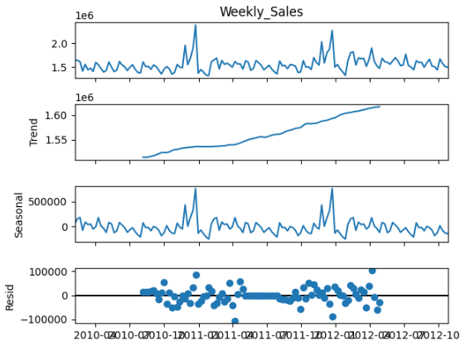
Looking at trend, seasonality and residue

Slide 20
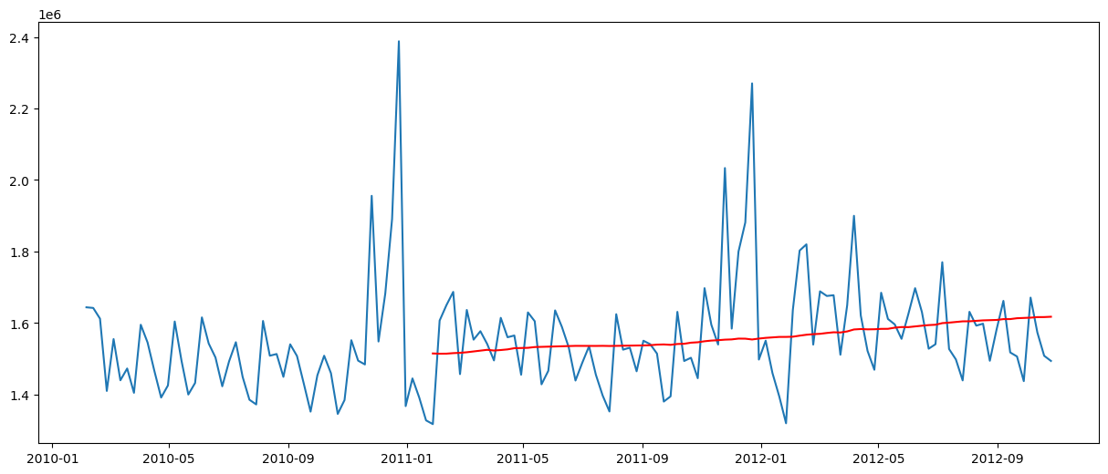
Assumed seasonality window = 52 weeks
Since plot of mean data gives a straight line with window =52 weeks

Slide 21
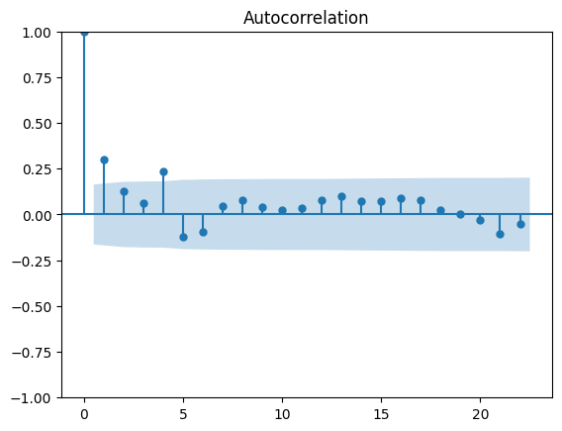
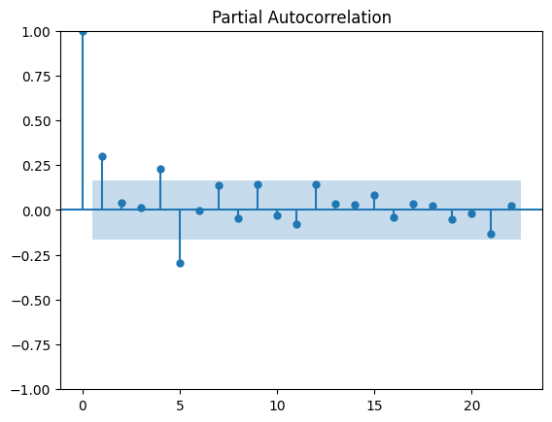
Conducted ACF & PACF Tests
Q value = 2
P value = 2

Slide 22
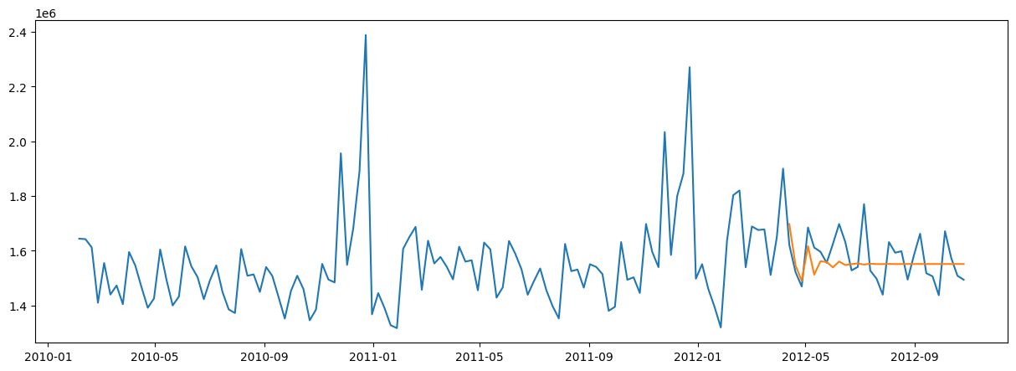
ARIMA Output

Slide 23
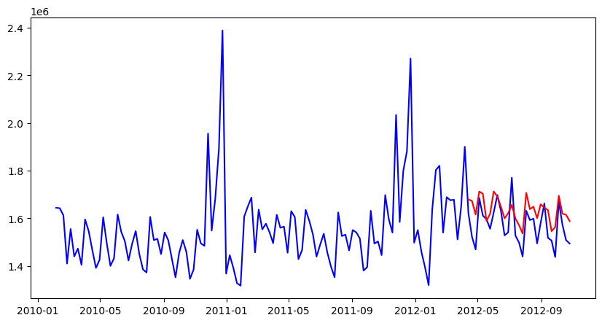
SARIMAX Output

Slide 24
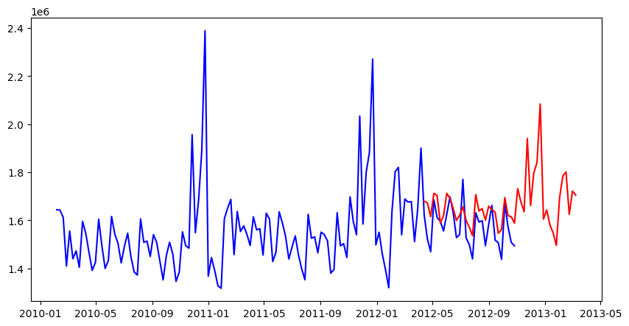
SARIMAX Predictions

Slide 25
Model Evaluation
For model evaluation technique used was finding RMSE values of both the model and whose RMSE value was less is considered the best model .
Inferences
Seasonality-
Model has detected and removed seasonality using Dicky Fuller test.
Discrepancies
Certain small discrepancies may happen because
Certain months have 5 weeks whereas most months have 4 weeks in the dataset.
Although outliers were removed- but it may still impact data prediction.
Overall
SARIMAX seems a good choice for time series prediction.

Slide 26
Future Potential
The model and its techniques can be extrapolated for other situations, industries, clients, problems for predicting time based data.
Conclusion
SARIMAX is a powerful tool/ ML algorithm to use for predictions
Data Cleaning is extremely important
Making the data stationary is very important
Great insights were drawn from the dataset

Slide 27
Thanks

